Slide 1











2019 Second International Conference on
Advanced Computational and Communication Paradigms
(ICACCP)
25 – 28 February, 2019
Technical Session #V Paper ID #. 1570507765
Brain Tumor Classification Using ResNet-101 Based Squeeze and Excitation Deep Neural Network
Swati Kanchan*, Lokesh Nandanwar*, Palash Ghosal, Ashok Bhadra, Jayasree Chakraborty, Debashis Nandi
Affiliations: NIT Durgapur, Medical College Kolkata, Memorial Sloan Kettering Cancer Center New York
swatikanchan070@gmail.com, lokeshnandanwar32@gmail.com

Slide 2

Paper Outline
1
Introduction
Block Diagram of Proposed Method
Dataset Description & Data Pre-processing
Proposed Methodology
Experimental Results & Discussions
Conclusion
Future Scope
References

Slide 3
Introduction
2
Current Indian Scenario
Lack of adequate doctors
Conventional Vs. computerized diagnosis
Our work

Slide 4

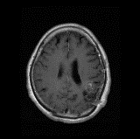
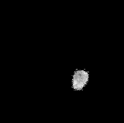
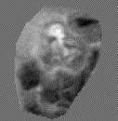





Block Diagram of Proposed Method
4
Augmented Images
Segmented Tumor (512 * 512)
Segmented Tumor (256 * 256)
SE-ResNet-101 CNN
T1 - weighted CE-MRI image
Normalized Image
One hot Encoded Output
Model
ROI
IN & ZC
[0, 1, 0]
Annotated Tumor Mask

Slide 5
Dataset Description
5
Source of Data
Nanfang Hospital, Guangzhou, China, and General Hospital, Tianjin Medical University, China(2005 to 2010)
Full Description
It contained 3064 T1-weighted contrast-enhanced images from 233 patients:
meningioma (708 slices)
glioma (1426 slices)
pituitary tumor (930 slices).
The dimension of each MRI slices: 512 × 512 pixels

Slide 6
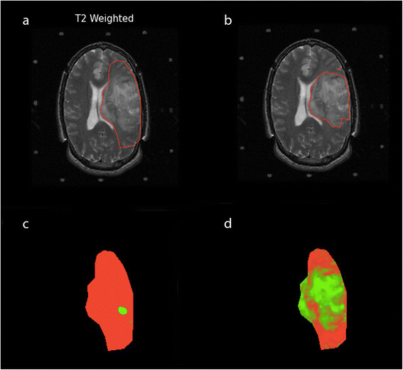
Data Pre-processing
6
ROI segmentation

Slide 7
Data Pre-processing
6
ROI segmentation
Intensity Zero-centering and Normalization

Slide 8
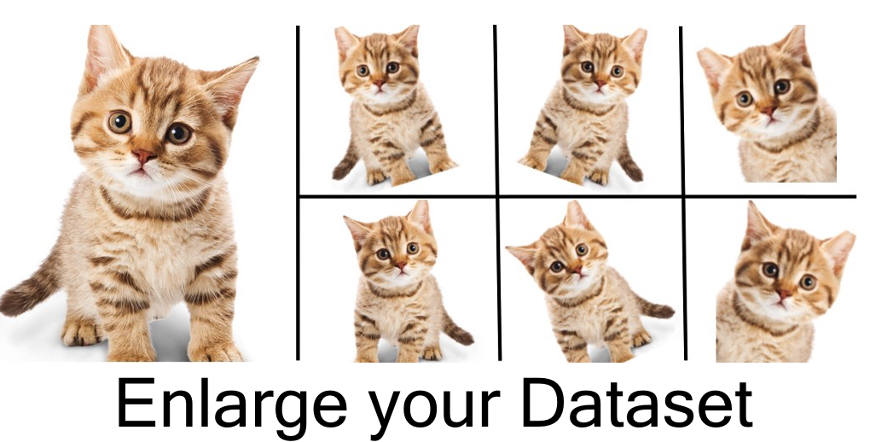
Data Pre-processing
6
ROI segmentation
Intensity Zero-centering and Normalization
Data Augmentation

Slide 9
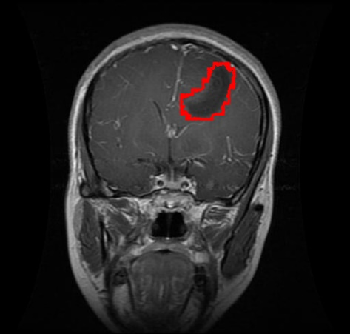
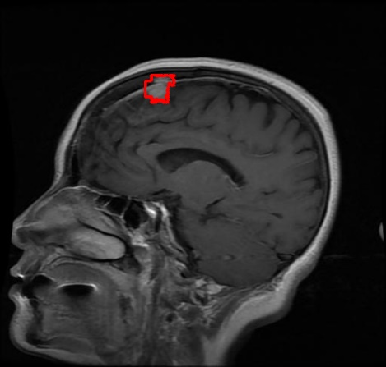
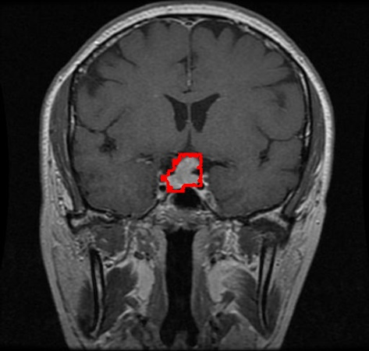
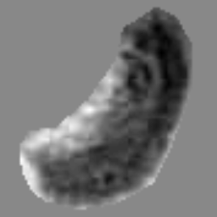
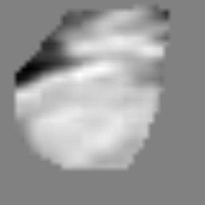
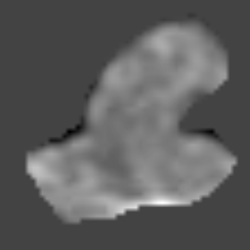
Preprocessed Images
7

Slide 10
Proposed Methodology
8
Deep Learning Model : ResNet-101
Subtraction of input features.
Shortcut connections - directly connecting the input of kth layer to (k + x)th layer.
Resolves the problem of vanishing gradients.
Weights amplifies the layer next to the present one.
101-layer Residual Network - modiﬁed version of the 50-layer ResNet.

Slide 11
Block Diagrams
9
X
Residual
W x H x C
X
Global Pooling
1 x 1 x C
Fully Connected
1 x 1 x C/r
Residual
ReLU
1 x 1 x C/r
Fully Connected
1 x 1 x C
Sigmoid
1 x 1 x C
X̃
Scale
W x H x C
W x H x C
a) ResNet Module
X̃
b) SE-ResNet Module

Slide 12
Squeeze and Excitation block with ResNet
10
Global Pooling - used to average the feature maps in a spatial plane.
Two fully connected layers:
with ReLU and Sigmoid activations are used for excitation operation.
Stacking the SE blocks.
SE-blocks combined with ResNet architecture, has performed outstandingly good in classifying the brain tumors.

Slide 13
Training of Model
6
Trained from scratch and ﬁnely tuned to just ﬁt.
Total data size = 7771:
3064 original samples
4707 samples of augmented data

Slide 14
Training of Model
6
Trained from scratch and ﬁnely tuned to just ﬁt.
Total data size = 7771:
3064 original samples
4707 samples of augmented data
Training duration = 7 hours
(batch size = 5 for 26,094 iterations):
12,196 iterations on original samples
13,898 iterations on augmented samples

Slide 15
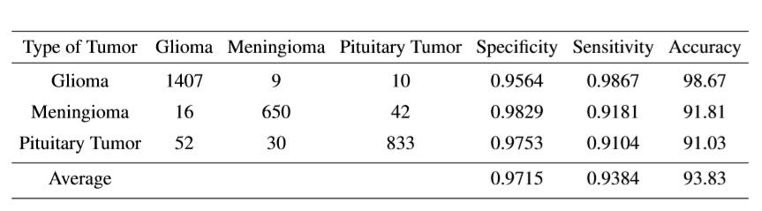
Experimental Results
6
Performance Metrics used for Evaluations are:
Categorical Accuracy i.e Accuracy
Speciﬁcity
Sensitivity
Cross-entropy loss

Slide 16
Experimental Results
6

Slide 17
Comparison of Proposed Method
6

Slide 18
Conclusion
7
State-of-the-art method
Handy tool to doctors
Other Applications

Slide 19
Future Scope
8
Extend to 3-dimensional MRI data
Covering more number of classes of tumors.

Slide 20
References
9
[1] J. Hu, L. Shen and G. Sun, “Squeeze-and-excitation networks,” in IEEE Conf. on CVPR 2018, pp. 7132-7141, 2018.
[2] K. He, X. Zhang, S. Ren, and J. Sun., “Deep residual learning for image recognition,” in Conf. on CVPR 2016, pp. 770-778, 2016.
[3] J. Cheng, et. al, “Enhanced Performance of Brain Tumor Classification via Tumor Region Augmentation and Partition,” in PloS one, vol. 10(12), 2015.
[4] J. S. Paul, A. J. Plassard, B. A. Landman, and D. Fabbri, “Deep learning for brain tumor classification,” in Proc. SPIE 10137, Medical Imaging 2017: Biomedical Applications in Molecular, Structural, and Functional Imaging, vol. 1013710, pp. 10137-16, 2017.
[5] J. Cheng, ``Brain tumor dataset''. figshare, 02-Apr-2017 [Online]. Available: https://figshare.com/articles/brain_tumor_dataset/1512427/5. [Accessed: 24-Dec-2018]

